Slide 1
Module 19: Security
The Security Problem
Authentication
Program Threats
System Threats
Threat Monitoring
Encryption

Slide 2
The Security Problem
Security must consider external environment of the system, and protect it from:
  unauthorized access.
  malicious modification or destruction
  accidental introduction of inconsistency.
Easier to protect against accidental than malicious misuse.

Slide 3
Authentication
User identity most often established through passwords, can be considered a special case of either keys or capabilities.
Passwords must be kept secret.
  Frequent change of passwords.
  Use of “non-guessable” passwords.
  Log all invalid access attempts.

Slide 4
Program Threats
Trojan Horse
  Code segment that misuses its environment.
  Exploits mechanisms for allowing programs written by users to be executed by other users.
Trap Door
  Specific user identifier or password that circumvents normal security procedures.
  Could be included in a compiler.

Slide 5
System Threats
Worms – use spawn mechanism; standalone program
Internet worm
  Exploited UNIX networking features (remote access) and bugs in finger and sendmail programs.
  Grappling hook program uploaded main worm program.
Viruses – fragment of code embedded in a legitimate program.
  Mainly effect microcomputer systems.
  Downloading viral programs from public bulletin boards or exchanging floppy disks containing an infection.
  Safe computing.

Slide 6
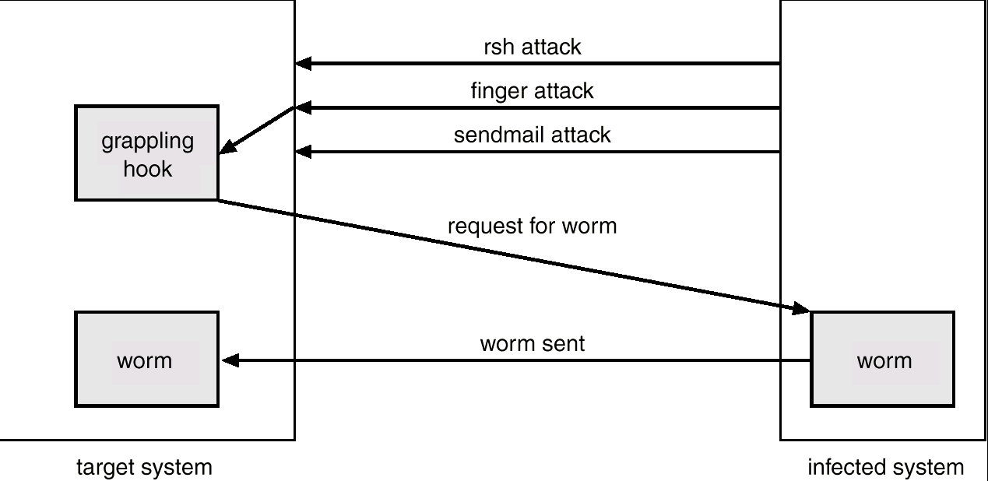
The Morris Internet Worm

Slide 7
Threat Monitoring
Check for suspicious patterns of activity – i.e., several incorrect password attempts may signal password guessing.
Audit log – records the time, user, and type of all accesses to an object; useful for recovery from a violation and developing better security measures.
Scan the system periodically for security holes; done when the computer is relatively unused.

Slide 8
Threat Monitoring (Cont.)
Check for:
  Short or easy-to-guess passwords
  Unauthorized set-uid programs
  Unauthorized programs in system directories
  Unexpected long-running processes
  Improper directory protections
  Improper protections on system data files
  Dangerous entries in the program search path (Trojan horse)
  Changes to system programs: monitor checksum values

Slide 9
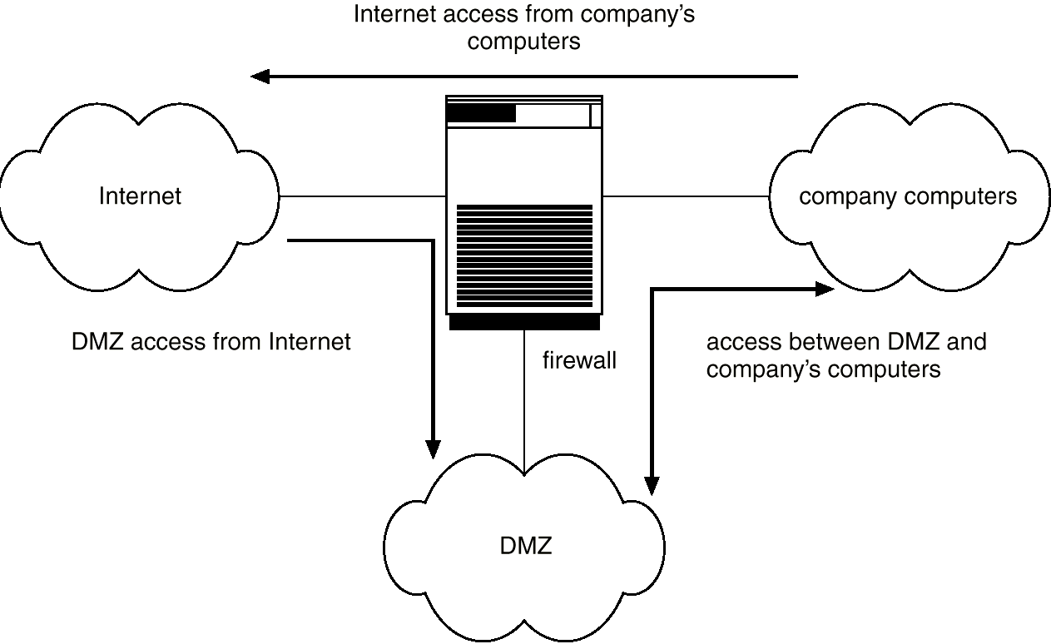
Network Security Through Domain Separation Via Firewall

Slide 10
Encryption
Encrypt clear text into cipher text.
Properties of good encryption technique:
  Relatively simple for authorized users to incrypt and decrypt data.
  Encryption scheme depends not on the secrecy of the algorithm but on a parameter of the algorithm called the encryption key.
  Extremely difficult for an intruder to determine the encryption key.
Data Encryption Standard substitutes characters and rearranges their order on the basis of an encryption key provided to authorized users via a secure mechanism. Scheme only as secure as the mechanism.

Slide 11
Encryption (Cont.)
Public-key encryption based on each user having two keys:
  public key – published key used to encrypt data.
  private key – key known only to individual user used to decrypt data.
Must be an encryption scheme that can be made public without making it easy to figure out the decryption scheme.
  Efficient algorithm for testing whether or not a number is prime.
  No efficient algorithm is know for finding the prime factors of a number.

Slide 12
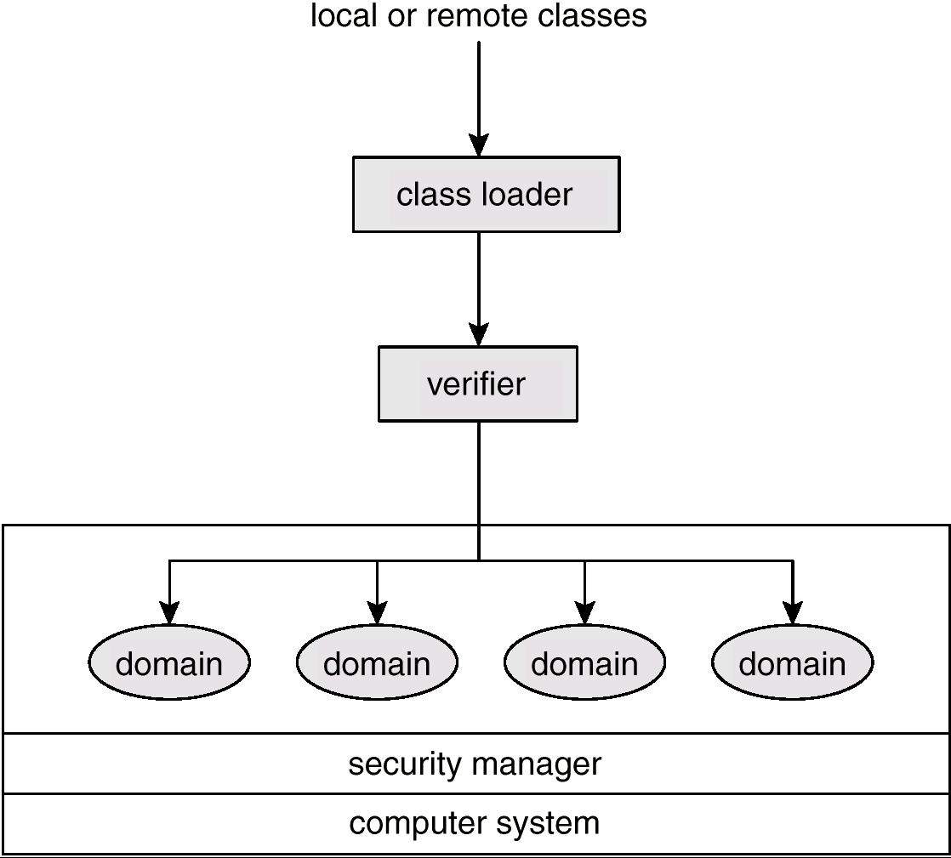
Java Security Model

